Slide 1
Nonlinear Dynamical Systems Workshop
Tuesday Afternoon

Slide 2
Overview (1:30)
RQA Metrics
CYO
Discussion
State Space Grids
cf Recurrence Plots
Examples
CYO
Markov Matrices
Comparison: RQA, SSG, and Markov

Slide 3
Words are categories! (1:35)
When considering truly categorical data, generally fewer unique values than when considering words
Example: NDSMacro1
Might want to change parameters (mindiagline, minvertline)
CYO
NDSMacro2 (or your own data; ideally two different sequences)
Compare the NDSMacro1 metrics to the NDSMacro2 metrics
Discussion: Convince your partner

Slide 4
RP Metrics: CYO (1:45)
Data: Categorical data
NDSMacro2
Macrocognitive codes (Ricca et al, 2020)
Same group, different day from NDSMacro1
Compare the metrics with each other; do they make sense?

Slide 5
State Space Grids (2:15)

Slide 6
State Space Grids (SSG) (2:15)
Categorical time series data
Categories on the axes, not time series
Focus on the categories, not the time
Example: NDSMacro1
ssg(pull(read.csv("https://bit.ly/NDSMacro1")))
ssg_metrics(pull(read.csv("https://bit.ly/NDSMacro1")))
Ugh…choose only some of the values

Slide 7
CYO SSG (2:30)
Use these data or your own
NDSMacro2
NDSTeacher1 (from Heleen Pennings)
NDSTeacher2 (from Heleen Pennings)
Discussion
Compare NDSMacro2 to NDSMacro1
Compare NDSTeacher1 to NDSTeacher2
Compare SSG results to RQA results

Slide 8
Markov Matrices (3:00)
Transition Probabilities (code i to code j)
Makes a matrix
These matrices are also one representation of networks
Matrix from NDSSpeakers (speakers of NDSMacro1)
Sequence: SKSSB SBKBS SKSKS BDSBS BDSSS BSBBS SBK
Matrix:
Caution: Sometimes transition matrices are written as the transpose
 | B | D | K | S
B | 0.10 | 0.20 | 0.20 | 0.50
D | 0.00 | 0.00 | 0.00 | 1.00
K | 0.25 | 0.00 | 0.00 | 0.75
S | 0.50 | 0.00 | 0.19 | 0.31

Slide 9
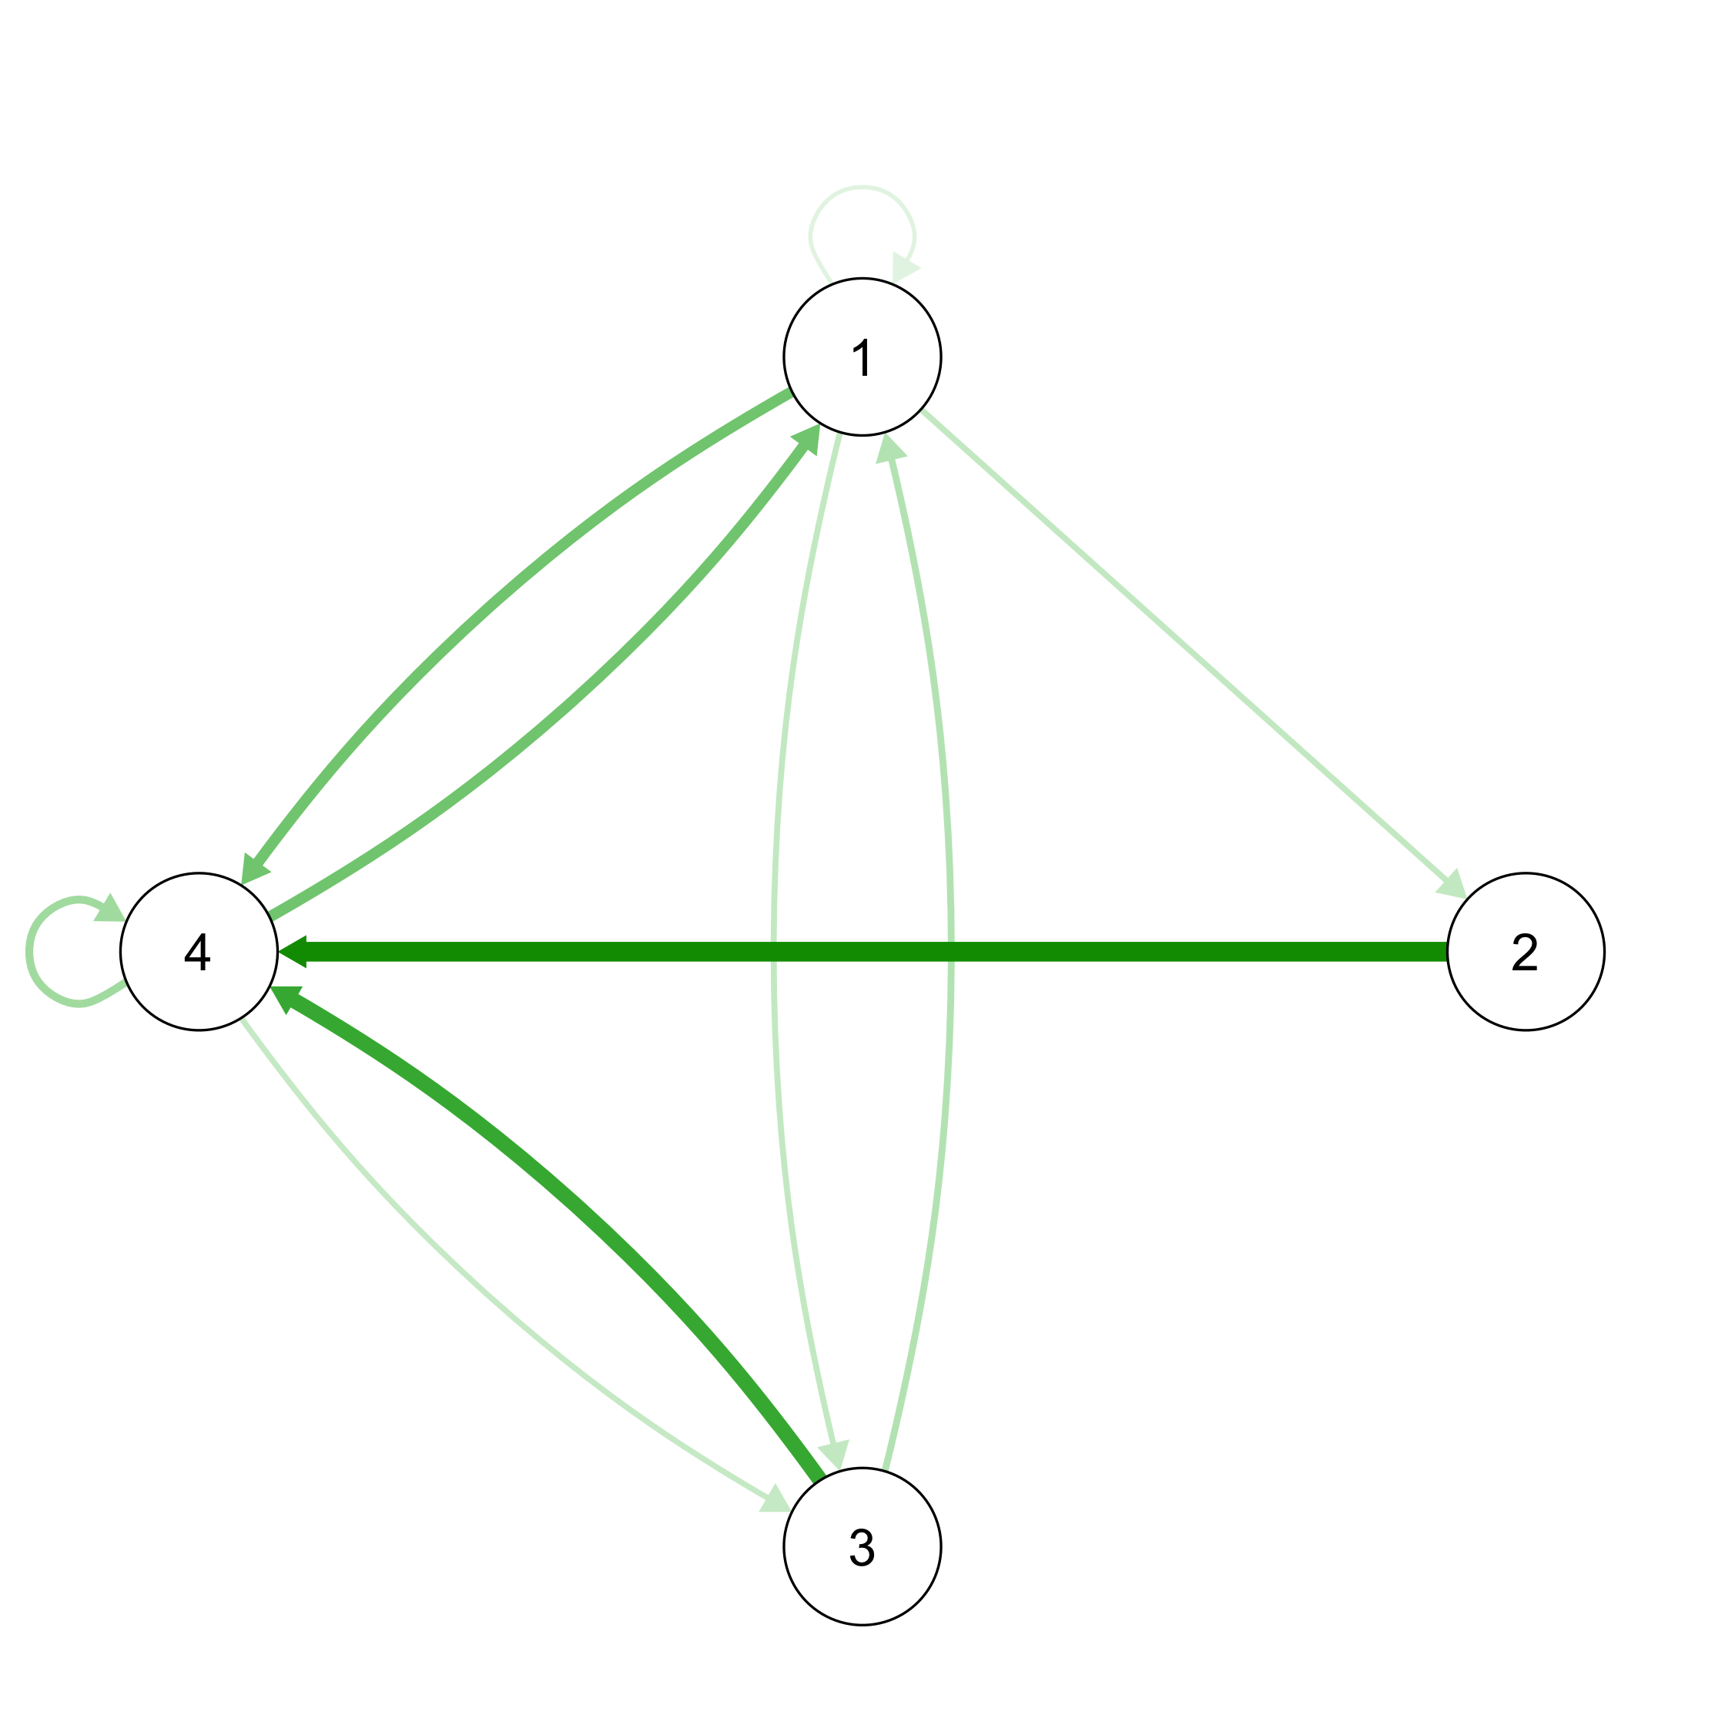
Plotting Transition Networks (3:05)
Matrix
Relative to the transitions from each node!
Transition Plot
 | 1 | 2 | 3 | 4
1 | 0.10 | 0.20 | 0.20 | 0.50
2 | 0.00 | 0.00 | 0.00 | 1.00
3 | 0.25 | 0.00 | 0.00 | 0.75
4 | 0.50 | 0.00 | 0.19 | 0.31

Slide 10
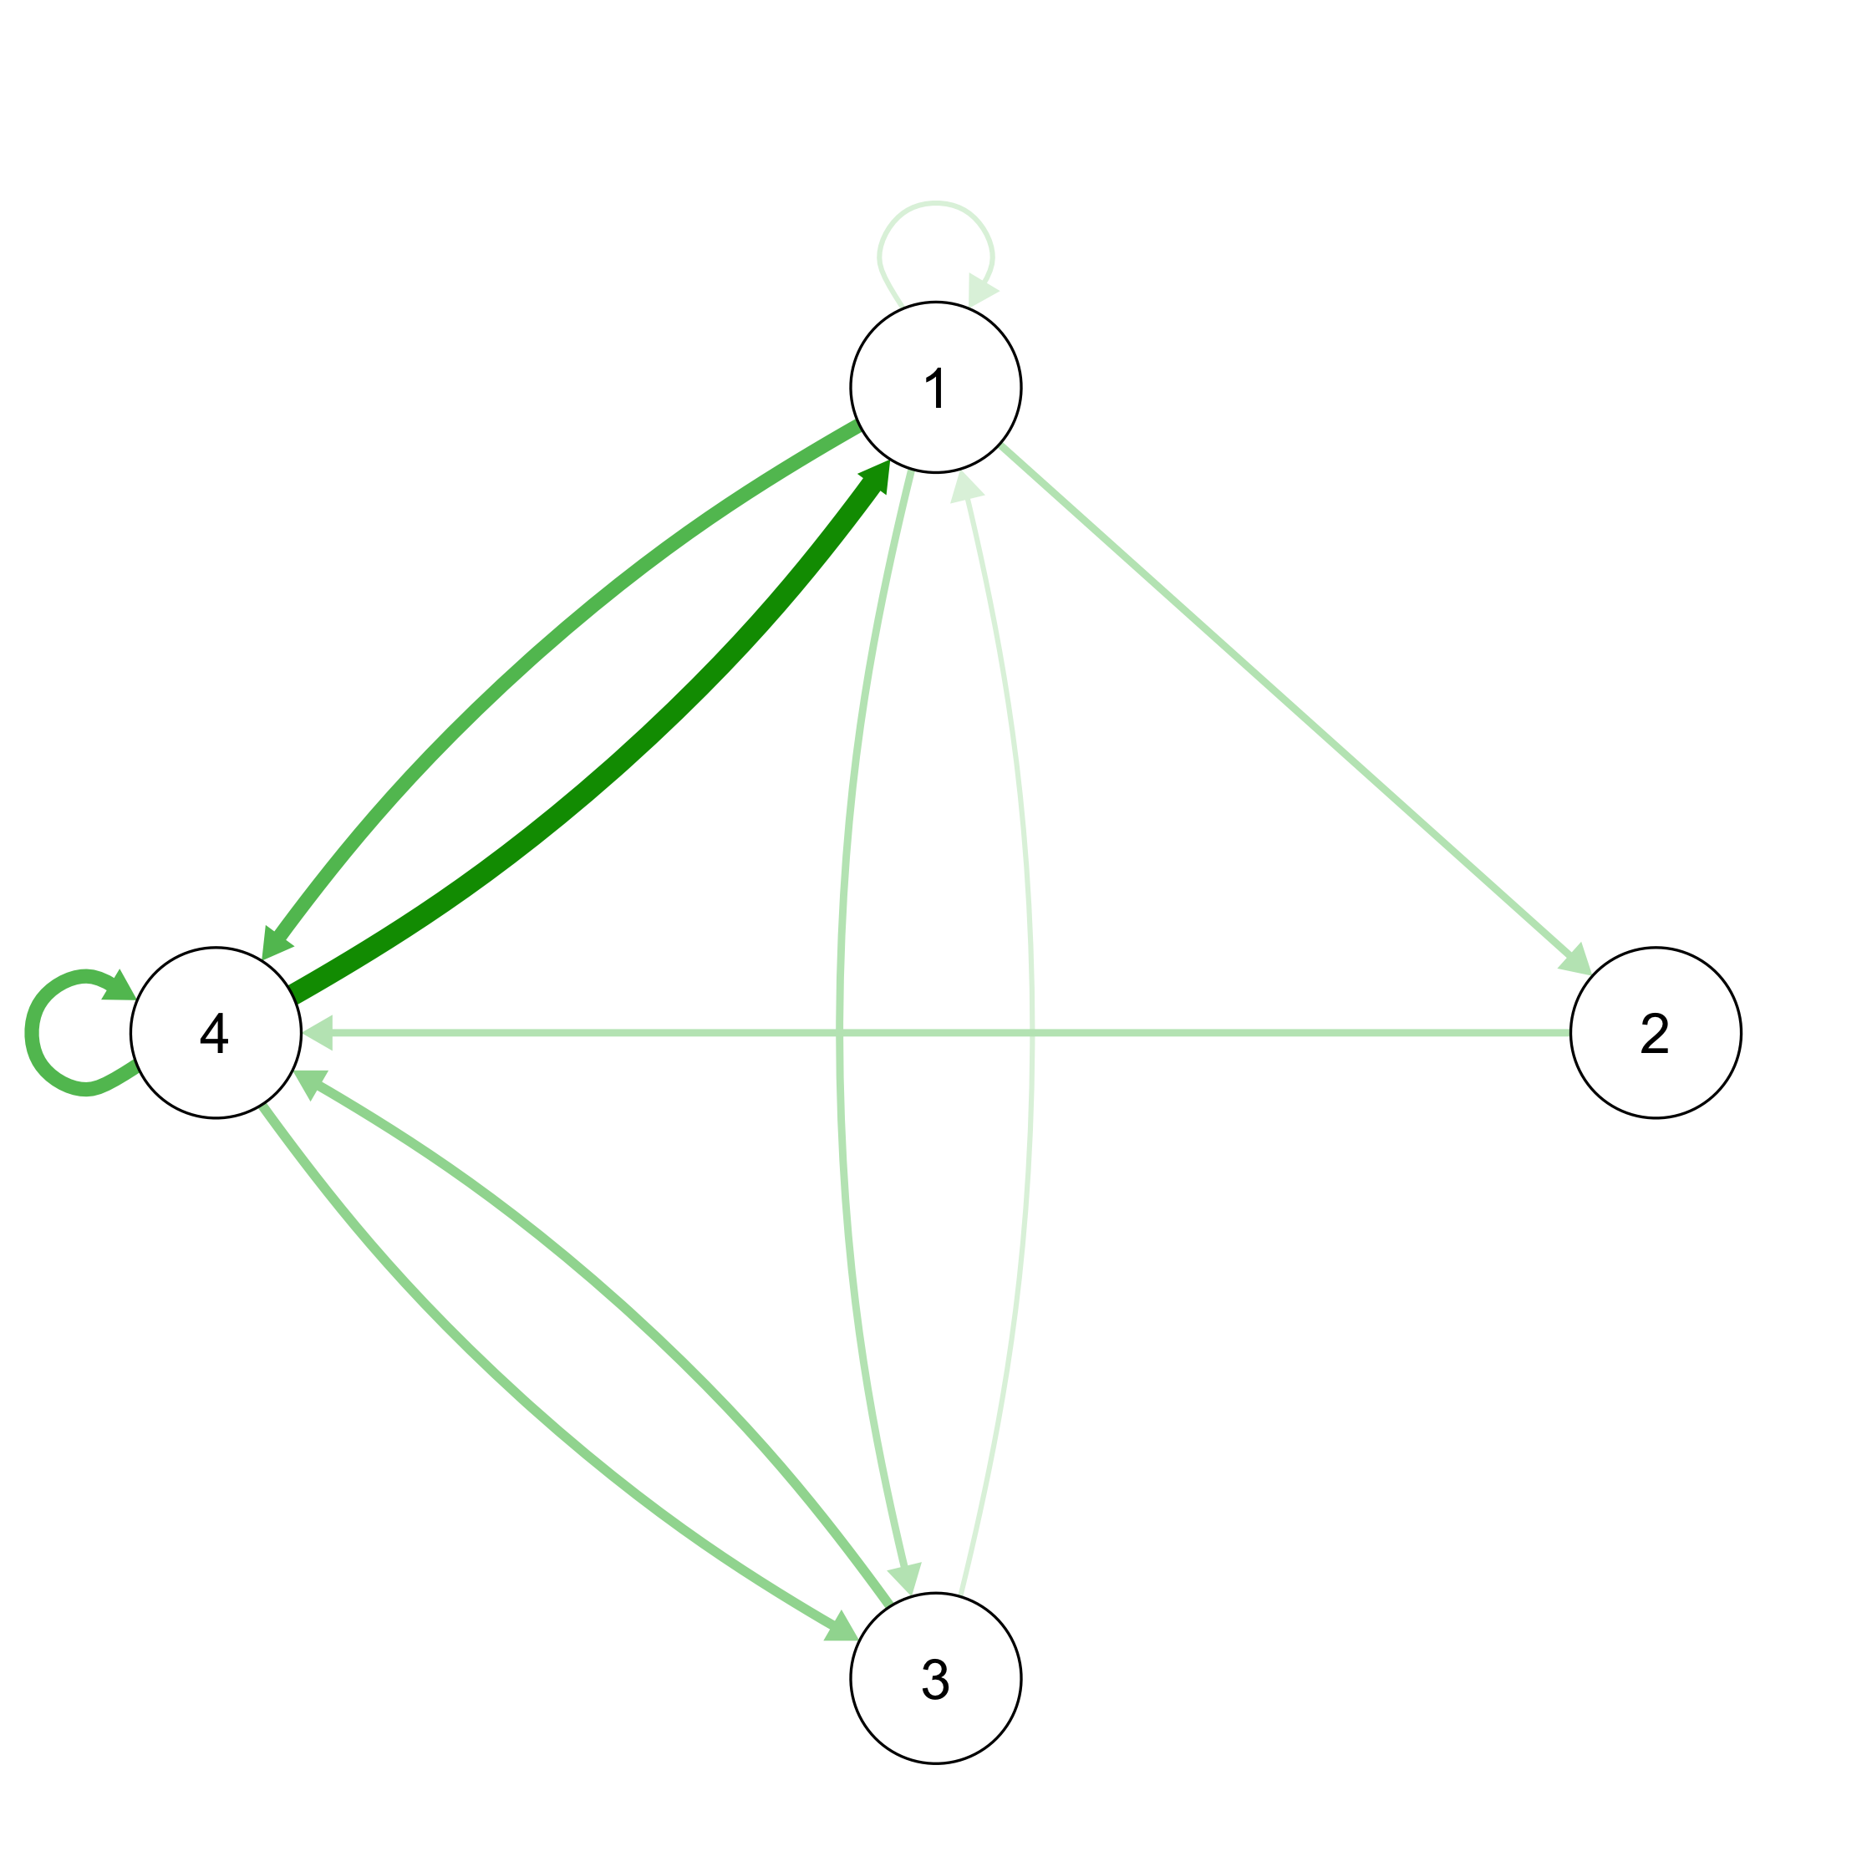
Plotting Transition Networks (Alternate)
Matrix
Relative to the total number of transitions, not each node!
Transition Plot
 | 1 | 2 | 3 | 4
1 | 0.03 | 0.06 | 0.06 | 0.16
2 | 0.00 | 0.00 | 0.00 | 0.06
3 | 0.03 | 0.00 | 0.00 | 0.09
4 | 0.25 | 0.00 | 0.09 | 0.16

Slide 11
Creating Markov matrices (3:15)
Make the transition matrix:
makeMarkov(pull(read.csv("https://bit.ly/NDSMacro1"))
Plot the transition matrix:
qgraph(makeMarkov(pull(read.csv("https://bit.ly/NDSMacro1")),
layout = “circle”)
Issue
Is one step enough to capture the dynamics? (Strelioff et al, 2007)
Don’t go here if you don’t have to…the math is ugly and I’m not sure I get it yet.

Slide 12
CYO (3:20)
Data: NDSMacro2
Compare to NDSMacro1
We’ll look at inference issues later in the week

Slide 13
The Three Alternatives (3:30)
Patterns (at mesoscales)
RQA
OD
Histories (Dynamics plus context)
SSG
RQA to some extent
Dynamics
Markov (assuming transitions capture dynamics)
Same dynamics can lead to many histories
Notes:
Really, can do inference with any of these via resampling; it is just harder with RQA and SSG.

Slide 14
Issues Involving the Three Alternatives
Later this week
Inference (via bootstrapping)
Clustering
What do you want to investigate, and why?
Dynamics, patterns, histories
Where do covariates fit in?

Slide 15
{Context + Dynamics} (if time)
Dynamics abstracted from Empirical Situation 1 |  |  | Dynamics abstracted from Empirical Situation 1
Empirical Situation 1 {Context 1 + Dynamics} |  |  | Empirical Situation 2 {Context 2 + Dynamics}
Abstract the dynamics
Apply the dynamics
Generalization?

Slide 16
Royall (Chapter 1; 1997) (if time)
“Consider a physician’s diagnostic test for the presence or absence of some disease, D. Suppose that experience has shown the test to be a good one, rarely producing misleading results. Specifically, the performance of the test is described by the probabilities shown” here:
 | Positive Test | Negative Test
Disease Present | 0.95 | 0.05
Disease Absent | 0.02 | 0.98

Slide 17
Royall (Chapter 1; 1997) (if time)
 | Positive Test | Negative Test
Disease Present | 0.95 | 0.05
Disease Absent | 0.02 | 0.98
“Now suppose that a patient, Mr Doe, is given the test. On learning that the result is positive,” what would your conclusion be?
“Mr Doe probably does not have D.”
“Mr Doe should be treated for D.”
“The test result is evidence that Mr Doe has D.”

Slide 18
Royall (Chapter 1; 1997) (if time)
Number 1 can true too!
Suppose the disease is very rare (e.g., 1% of the population)
 |  | 10000 people
100 with disease |  |  | 9900 without disease
95 positive tests | 5 “false negatives” |  | 198 “false positives” | 9702 negative tests

Slide 19
Wrapping Up (4:25)
Please take the two-question survey
Give one good thing about today’s sessions
Give one thing that could have improved today’s sessions
Link: http://bit.ly/TuesdaySurvey

